Slide 1
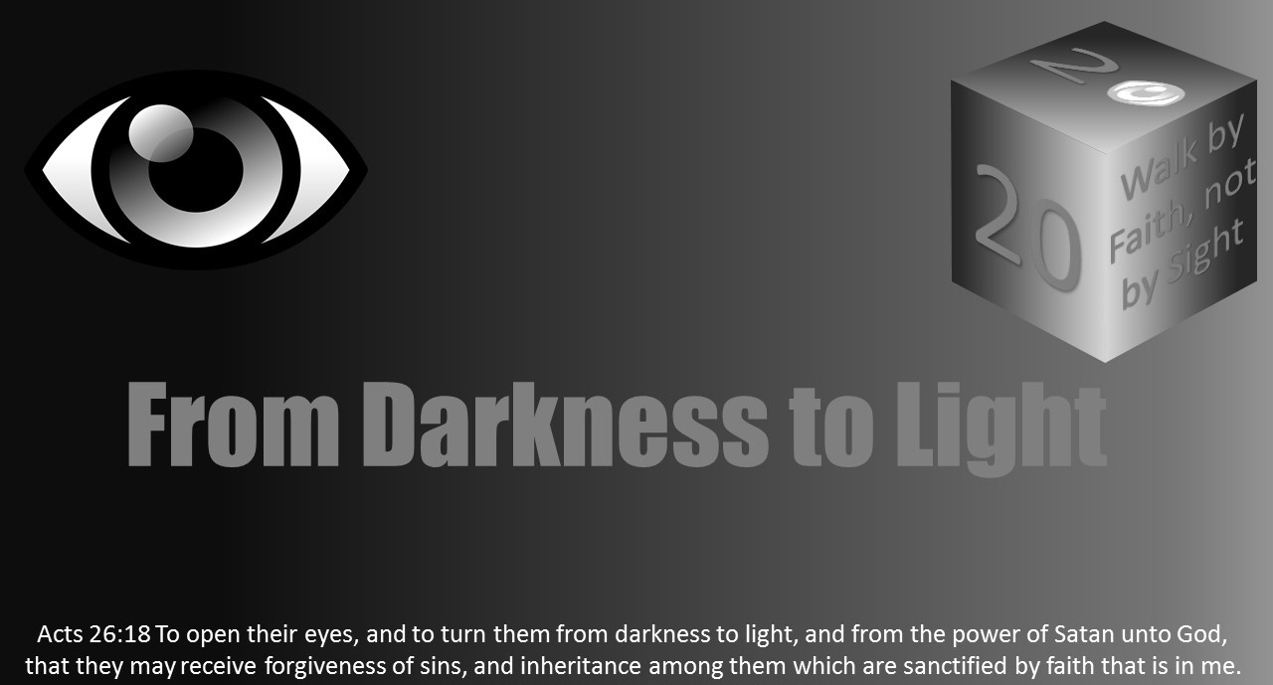


Slide 2


Slide 3

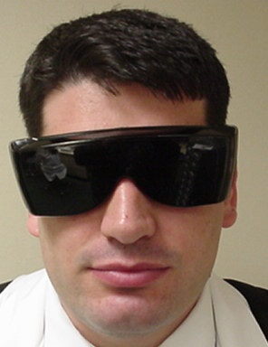
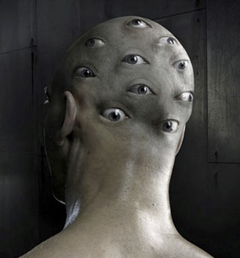
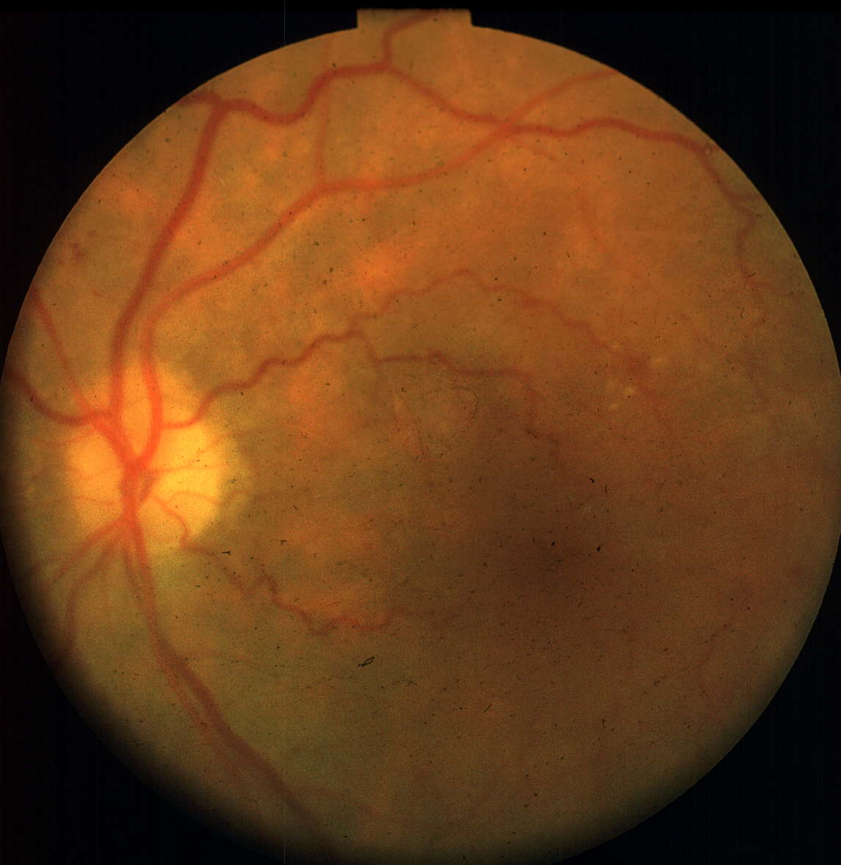
Darkness Lesson 2: Causes of Spiritual Blindness

Slide 4
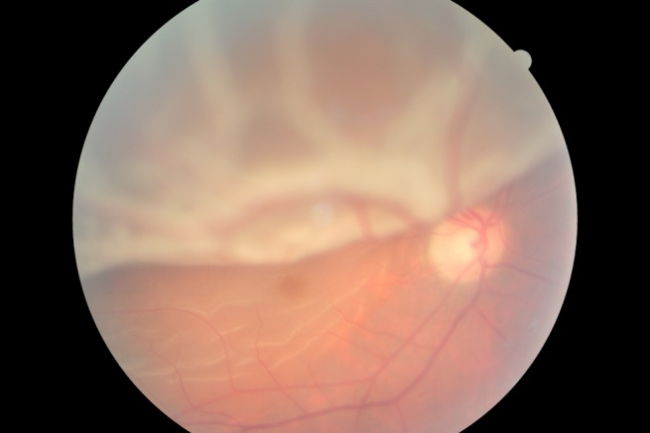
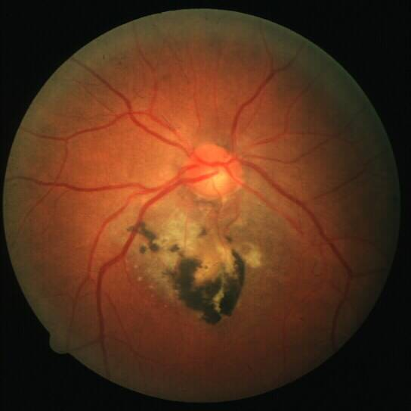
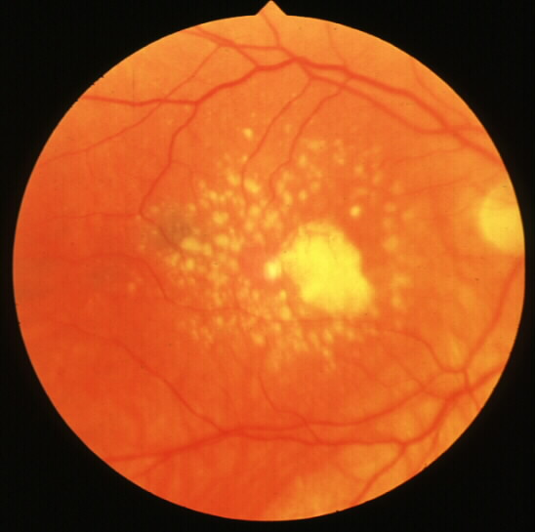
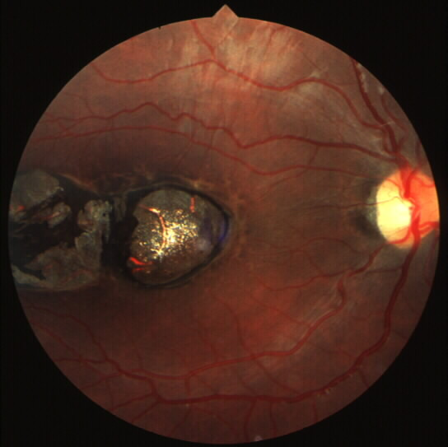
Causes of Blindness
Legal definition
Causes
Macular Degeneration
Diabetic Retinopathy
Glaucoma
Toxoplasmosis
10,000 disease - 1,000 effectively treatable
Terrifying idea to most
Notes:
Top Left : Retinal Detachment
Middle: Macular Degeneration
Right: Toxoplasmosis/histplasmosis
The idea of going blind terrifies most people even though many take their vision for granted. It is estimated there are 10,000 diseases of the human eye; about 1,000 can be effectively treated or managed.
Some of these diseases lead to blindness such as diabetic retinopathy, macular degeneration, toxoplasmosis, glaucoma, and retinitis pigmentosa.
Too often, early in the disease process, the disease slowly creeps up on a person so they do not even notice it slowly taking their eyesight. The longer they go without identifying the cause and treating the disease when treatable, the more likely they are to wait until such treatment is not effective and blindness results.
The eye as a point of understanding, indicates how humans are generally sight dependent for everything.
It is estimated 75-80% of learning is visual. Human language also illustrates this.
Consider phrases such as Missouri’s “Show me” slogan or “I will believe it when I see it.”
What if one could know the cause of blindness and avoid it?
Similar to physical blindness, Christians and people in general are often in denial about sin and the impact it has on them.
Sin spiritually blinds.
When the eye becomes focused on self and carnal things, there is no eternal viewpoint or focus on the eternal. There is no keeping one's eye on Christ.

Slide 5
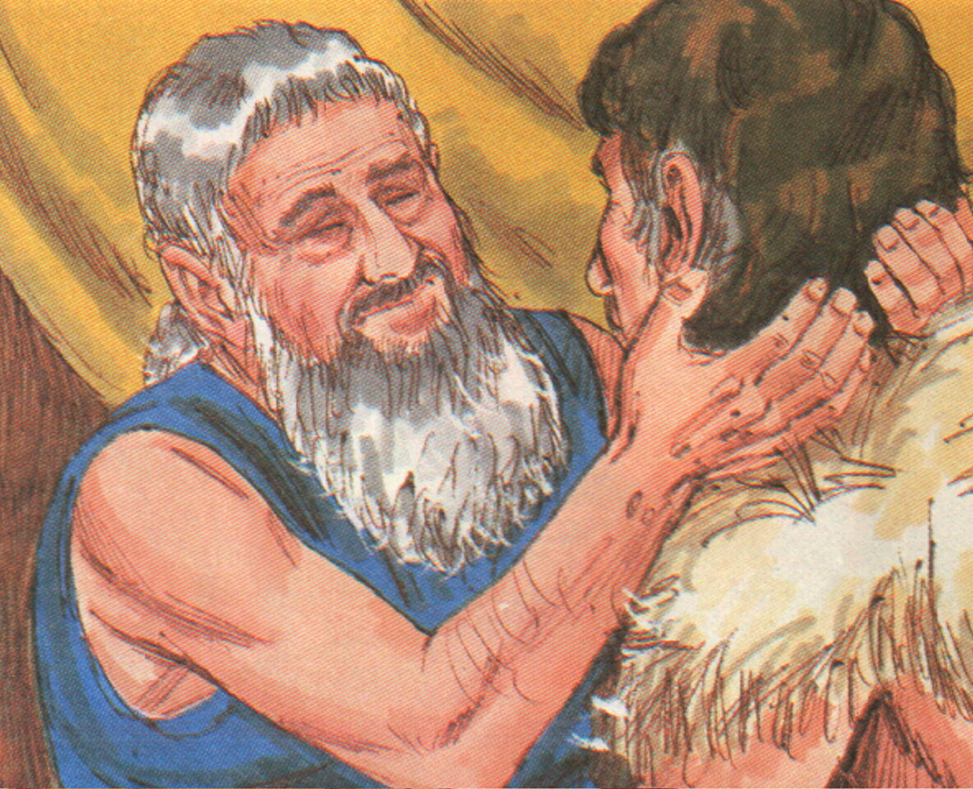
Bible speaks lots of blindness
Many who served God were blind: Issac, Jacob, Eli, Ahijah
Cruelty to forbidden - Lev 19:14, Deut 27:18
Disqualified priest - Lev 21:18
Animals not sacrificed - Lev 22:22
Elisha asked God to blind Armeneans (saves battle) - 2 Kings 6:18-23
Sodomites blinded because of their sinful intent - Gen 19:1
Blindness on magician Elymas - Acts 13:11
Curse for disobedience - Deut 28:28

Slide 6
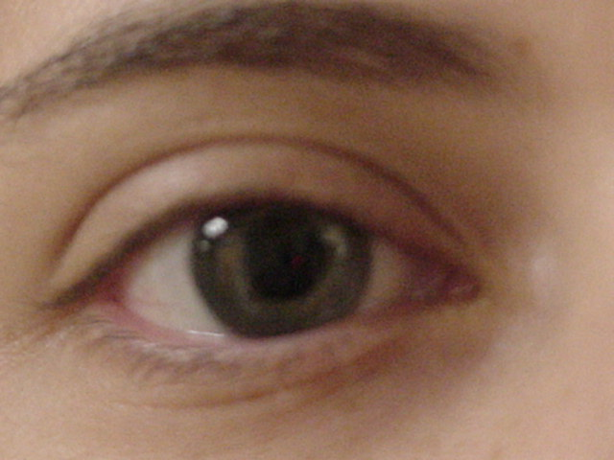
Spiritual Blindness
Eye seen as point of understanding
Sight dependent people
Own language
Believe it when I see it
Show me
~75% of learning is visual
Spiritual blindness
Causes
Combating it
Notes:
What if one could know the cause of blindness and avoid it? Like physical blindness, Christians and people, in general, are often in denial about sin and the impact it has on them. Sin spiritually blinds. When the eye becomes focused on self and carnal things, there is no eternal viewpoint or focus on the eternal. There is no keeping one's eye on Christ.

Slide 7
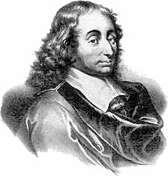
Spiritual Blindness
Inability to comprehend spiritual truths.
“In faith there is enough light for those who want to believe and enough shadows to blind those who don’t.” - Blaise Pascal
Notes:
Spiritual blindness is the inability to comprehend spiritual truths.
The eyes are indeed useless when the mind is blind.
Mathematician and theologian Blaise Pascal of the 1600s expressed it this way, “In faith there is enough light for those who want to believe and enough shadows to blind those who don’t.”

Slide 8

Spiritual Blindness
John 9:39-21 “And Jesus said, For judgment I am come into this world, that they which see not might see; and that they which see might be made blind. And some of the Pharisees which were with him heard these words, and said unto him, Are we blind also? Jesus said unto them, If ye were blind, ye should have no sin: but now ye say, We see; therefore your sin remaineth.”
Notes:
Jesus helps one see the relationship between sight, faith, and spiritual blindness.
In John 9:39-21, Jesus taught “For judgment I am come into this world, that they which see not might see; and that they which see might be made blind. And some of the Pharisees which were with him heard these words, and said unto him, Are we blind also? Jesus said unto them, If ye were blind, ye should have no sin: but now ye say, We see; therefore your sin remaineth.”

Slide 9
Spiritual Blindness
Isaiah 42:16-20: “And I will bring the blind by a way that they knew not; I will lead them in paths that they have not known: I will make darkness light before them, and crooked things straight. These things will I do unto them, and not forsake them. They shall be turned back, they shall be greatly ashamed, that trust in graven images, that say to the molten images, Ye are our gods. Hear, ye deaf; and look, ye blind, that ye may see. Who is blind, but my servant? or deaf, as my messenger that I sent? who is blind as he that is perfect, and blind as the LORD'S servant? Seeing many things, but thou observest not; opening the ears, but he heareth not.”
Notes:
This relationship was also noted in Isaiah 42:16-20: “And I will bring the blind by a way that they knew not; I will lead them in paths that they have not known: I will make darkness light before them, and crooked things straight. These things will I do unto them, and not forsake them. They shall be turned back, they shall be greatly ashamed, that trust in graven images, that say to the molten images, Ye are our gods. Hear, ye deaf; and look, ye blind, that ye may see. Who is blind, but my servant? or deaf, as my messenger that I sent? who is blind as he that is perfect, and blind as the LORD'S servant? Seeing many things, but thou observest not; opening the ears, but he heareth not.”

Slide 10
Spiritual Blindness
Paul identified spiritual blindness in Ephesians 4:17-19 as when one’s mind is darkened when he wrote, “This I say therefore, and testify in the Lord, that ye henceforth walk not as other Gentiles walk, in the vanity of their mind, Having the understanding darkened, being alienated from the life of God through the ignorance that is in them, because of the blindness of their heart: Who being past feeling have given themselves over unto lasciviousness, to work all uncleanness with greediness.”
Notes:
Paul identified spiritual blindness as when one’s mind is darkened in Ephesians 4:17-19. “This I say therefore, and testify in the Lord, that ye henceforth walk not as other Gentiles walk, in the vanity of their mind, Having the understanding darkened, being alienated from the life of God through the ignorance that is in them, because of the blindness of their heart: Who being past feeling have given themselves over unto lasciviousness, to work all uncleanness with greediness.”

Slide 11
Spiritual Blindness
Many remain spiritually blind despite Jesus wanting to give them their sight.
Jesus (quoting Isaiah) taught in Matthew 13:14-16, “For this people's heart is waxed gross, and their ears are dull of hearing, and their eyes they have closed; lest at any time they should see with their eyes, and hear with their ears, and should understand with their heart, and should be converted, and I should heal them. But blessed are your eyes, for they see: and your ears, for they hear. For verily I say unto you, That many prophets and righteous men have desired to see those things which ye see, and have not seen them; and to hear those things which ye hear, and have not heard them.”
The world has been pulled over the eyes of many. Satan has polluted their minds and tainted their view, darkening their thoughts.
Notes:
Many remain spiritually blind despite Jesus wanting to give them their sight.
Jesus (quoting Isaiah) taught in Matthew 13:14-16, “For this people's heart is waxed gross, and their ears are dull of hearing, and their eyes they have closed; lest at any time they should see with their eyes, and hear with their ears, and should understand with their heart, and should be converted, and I should heal them. But blessed are your eyes, for they see: and your ears, for they hear. For verily I say unto you, That many prophets and righteous men have desired to see those things which ye see, and have not seen them; and to hear those things which ye hear, and have not heard them.”
The world has been pulled over the eyes of many.
Satan has polluted their minds and tainted their view, darkening their thoughts.
Instead of escaping the corruption of the world and becoming partakers of the divine nature as God has offered, many are spiritually blind.
So, what causes spiritual blindness?

Slide 12
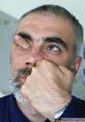

Causes of Spiritual Blindness: Pride
Prov 21:2-4 every way of a man is right in his own eyes: but the LORD pondereth the hearts. ³To do justice and judgment is more acceptable to the LORD than sacrifice. ⁴An high look, and a proud heart, and the plowing of the wicked, is sin.
Prov 6:17 - Haughty eyes are an abomination to the Lord
Notes:
Pride causes spiritual blindness.
Pride prevents one from seeking God’s truth and remaining ignorant.
Christians are not immune from this "I" problem.
Proverbs 21:2-4 teaches, “Every way of a man is right in his own eyes: but the LORD pondereth the hearts. To do justice and judgment is more acceptable to the LORD than sacrifice. An high look, and a proud heart, and the plowing of the wicked, is sin.”
Proverbs 6:17 summarizes “Haughty eyes are an abomination to the Lord.”

Slide 13
Causes of Spiritual Blindness: Pride
Prov 30:11-13 There is a generation that is pure in its own eyes, Yet is not washed from its filthiness. ¹³There is a generation— oh, how lofty are their eyes! And their eyelids are lifted up.
Notes:
Proverbs 30:11-13 encourages, “There is a generation that is pure in its own eyes, Yet is not washed from its filthiness. There is a generation— oh, how lofty are their eyes! And their eyelids are lifted up.”
Pride blinds humans so easily to even the truths in their own lives.
The Big-Me-Little-You syndrome of pride causes one to miss so much. Because their perception of reality is so skewed, they are often blind to reality, not only in this life but especially from an eternal perspective.
The wisdom of God for those are spiritually blind may seem like foolishness. But in the end, God will demonstrate His wisdom (1 Cor. 1:18-21).

Slide 14
Causes of Spiritual Blindness: Self-righteousness
Paul writes about how Israel was ignorant of God’s righteousness and sought their own.
Romans 10:1-3 : “Brethren, my heart's desire and prayer to God for Israel is, that they might be saved. For I bear them record that they have a zeal of God, but not according to knowledge. For they being ignorant of God's righteousness, and going about to establish their own righteousness, have not submitted themselves unto the righteousness of God.”
They failed to see their self-righteousness as filthy rags (Isa 64:6).
Righteousness trusts in the Lord, not in one’s own understanding.
Righteousness is not confidence in self-wisdom, but acknowledges and fears God (Prov 3:5-7).
Notes:
Self-righteousness causes spiritual blindness.
Paul writes how Israel was ignorant of God’s righteousness and sought their own.
Romans 10:1-3 reads: “Brethren, my heart's desire and prayer to God for Israel is, that they might be saved. For I bear them record that they have a zeal of God, but not according to knowledge. For they being ignorant of God's righteousness, and going about to establish their own righteousness, have not submitted themselves unto the righteousness of God.” They failed to see their self-righteousness as filthy rags (Isa. 64:6).
Righteousness trusts in the Lord, not in one’s own understanding. Righteousness is not confidence in self-wisdom, but acknowledges and fears God (Prov. 3:5-7).

Slide 15
Causes of Spiritual Blindness: Self-righteousness
In Luke 18:9, Jesus would tell a parable to teach about self-righteousness. “And he spake this parable unto certain which trusted in themselves that they were righteous, and despised others.” In verses 10-14, Jesus teaches about the Publican and the Pharisee. He challenges in verse 14 “….for every one that exalteth himself shall be abased; and he that humbleth himself shall be exalted.”
Self-righteousness is self-centered and treats other with contempt.
The legalism of the Pharisees was also self-righteousness.
Christ challenged them to the weightier matters of the law such as judgment, mercy, and faith without leaving the details of mint, anise, and cummin.
Self-righteousness blinds one’s heart with self-approval and false confidence
Notes:
In Luke 18:9, Jesus uses a parable to teach about self-righteousness. “And he spake this parable unto certain which trusted in themselves that they were righteous, and despised others.” In verses 10-14, Jesus teaches about the Publican and the Pharisee. He challenges in verse 14 “…for everyone that exalteth himself shall be abased; and he that humbleth himself shall be exalted.”
Self-righteousness is associated with pride and a failure to know God’s word.
Self-righteousness is self-centered and treats others with contempt.
The legalism of the Pharisees was also self-righteousness.
Christ challenged them to the weightier matters of the law such as judgment, mercy, and faith without leaving the details of mint, anise, and cumin.
Self-righteousness blinds one’s heart with self-approval and false confidence.

Slide 16
Causes of Spiritual Blindness: Lust
1 John 2:15-17 Do not love the world or the things in the world. If anyone loves the world, the love of the Father is not in him. ¹⁶For all that is in the world—the lust of the flesh, the lust of the eyes, and the pride of life—is not of the Father but is of the world. ¹⁷And the world is passing away, and the lust of it; but he who does the will of God abides forever.
Notes:
Lust causes spiritual blindness.
1 John 2:15-17 teaches, “Do not love the world or the things in the world. If anyone loves the world, the love of the Father is not in him. For all that is in the world—the lust of the flesh, the lust of the eyes, and the pride of life—is not of the Father but is of the world. And the world is passing away, and the lust of it; but he who does the will of God abides forever.”
Lust is an inordinate desire such as covetousness or greed.
It is an excessive desire for a possessions or consumption of something, often sexual.
As a result, lust frequently skews one’s vision of reality to the point of spiritual blindness.

Slide 17
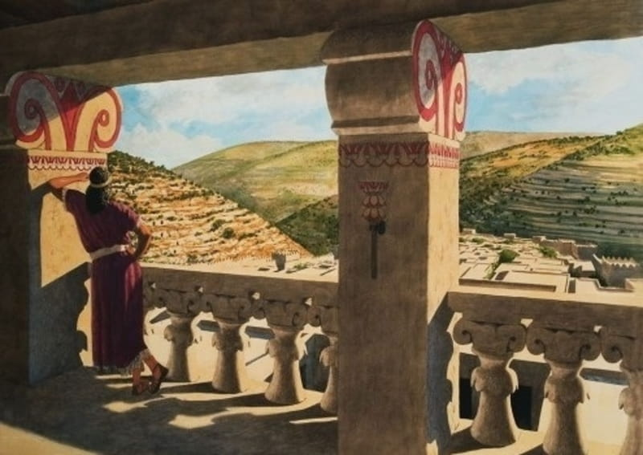
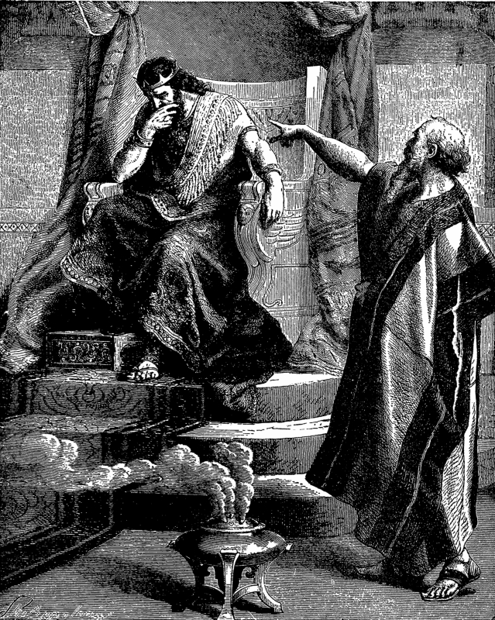
Causes of Spiritual Blindness: Lust – David and Bathsheba
Notes:
King David’s experience with Bathsheba is a strong example.
David saw Bathsheba bathing and allowed his lust of the eyes and flesh to take root.
As a result, he committed adultery.
He then tried to cover Bathsheba’s pregnancy and had her spouse murdered to take her as his wife (2 Sam. 11-12).
David’s lust seemed to have blinded him to his sin until the prophet Nathan told him the story about a rich man who took a poor man’s only lamb. The story of the man with one lamb made David indignant in judgment.
He was so blind to his own sin that he failed to see that Nathan was speaking of him until Nathan tells him, “Thou art the man.” (2 Sam 12:7).
David was hit with his spiritual blindness and sin. His inordinate desire for Bathsheba led to many sins, and Nathan finally helped David see his sins as repugnant.

Slide 18
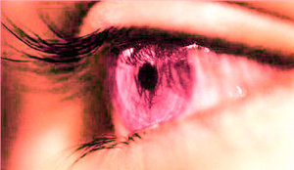
Causes of Spiritual Blindness: Lust
Prov 6:25 -29 Lust not after her beauty in thine heart; neither let her take thee with her eyelids. ²⁶For by means of a whorish woman a man is brought to a piece of bread: and the adulteress will hunt for the precious life. ²⁷Can a man take fire in his bosom, and his clothes not be burned? (see also Prov 7:7-23)
Notes:
Many a man or woman has so desired another sexually that they lost all clear thinking, willingly throwing away reputation, a marriage, or a life they had worked hard to construct.
Proverbs 6:25-29 warns, “Lust not after her beauty in thine heart; neither let her take thee with her eyelids. For by means of a whorish woman a man is brought to a piece of bread: and the adulteress will hunt for the precious life. Can a man take fire in his bosom, and his clothes not be burned?” (See also Prov. 7:7-23).
The enticement to sin because of lust seems to place blinders on its sufferers.
18

Slide 19
Causes of Spiritual Blindness: Lust
Need to guard your heart
Psalm 1:1-2
Notes:
Everyone, specifically christians, need to guard their heart.
They must avert their eyes and redirect their feet from the environments where they are enticed to lust. For what one puts in their heart will take root and grow.
One cannot avoid all exposure to tempting environments, but too often one looks, lingers, lounges, and is ensnared by sin (Psa. 1:1-2).
Thus, one must avoid places and media that lead to a path of lust.
God has provided a plan to meet a person’s need with all its benefits and protections.

Slide 20

Causes of Spiritual Blindness: Lust
God has given covenant relationship of marriage between husband and wife (Gen 2:24)
When Gentiles failed to recognize God, eventually they became depraved minds
Romans 1:19-32
Given over to their lusts
Notes:
In terms of sexuality, God has created a covenant relationship of marriage between a wife and a husband (Gen. 2:24).
Ultimately though, when the Gentiles failed to recognize God, eventually they became depraved minds, and they are given over to their lusts.
Noticed how Paul expressed it in Romans 1:19-32: “Because that which may be known of God is manifest in them; for God hath shewed it unto them. For the invisible things of him from the creation of the world are clearly seen, being understood by the things that are made, even his eternal power and Godhead; so that they are without excuse: Because that, when they knew God, they glorified him not as God, neither were thankful; but became vain in their imaginations, and their foolish heart was darkened. Professing themselves to be wise, they became fools, And changed the glory of the uncorruptible God into an image made like to corruptible man, and to birds, and fourfooted beasts, and creeping things. Wherefore God also gave them up to uncleanness through the lusts of their own hearts, to dishonour their own bodies between themselves: Who changed the truth of God into a lie, and worshipped and served the creature more than the Creator, who is blessed for ever. Amen. For this cause God gave them up unto vile affections: for even their women did change the natural use into that which is against nature: And likewise also the men, leaving the natural use of the woman, burned in their lust one toward another; men with men working that which is unseemly, and receiving in themselves that recompence of their error which was meet. And even as they did not like to retain God in their knowledge, God gave them over to a reprobate mind, to do those things which are not convenient; Being filled with all unrighteousness, fornication, wickedness, covetousness, maliciousness; full of envy, murder, debate, deceit, malignity; whisperers, Backbiters, haters of God, despiteful, proud, boasters, inventors of evil things, disobedient to parents, Without understanding, covenantbreakers, without natural affection, implacable, unmerciful: Who knowing the judgment of God, that they which commit such things are worthy of death, not only do the same, but have pleasure in them that do them.

Slide 21
Causes of Spiritual Blindness: Lust
Is American culture described by Romans 1?
Prov 4:19 The way of the wicked is like darkness; They do not know what makes them stumble.
Notes:
The mind of such folks has been blinded as their understanding is darkened, ignorant of God’s promises, blinded in their heart, beyond feeling such that they are given over to lasciviousness, uncleanness, and greediness.
In America’s current culture, sexuality and lust of the flesh are used to entice. Women’s and men's bodies are used to sell clothes, music, cars, and everything under the sun. Women are culturally sold on the idea of sexually presenting their bodies to the world around them. Be honest, the skimpy bikini is not for comfort. It is designed to “hang out the sign.” Men are supposed to not react or be provoked in a politically correct culture, but they are reacting. This does not justify one who would rape or lust, but clearly there is a creation of tension by intent.
Thus, pornography is rampantly consumed. This consumption cheapens the sexual relationship, such that American culture has become the Romans 1 culture. In time, one is stumbling in darkness.
(Earlier) Proverbs 4:19 explains, “The way of the wicked is like darkness; They do not know what makes them stumble.”
Children of God must guard their hearts and avert their eyes when possible.
In American society, much like the culture described in Romans 1, one can hardly pass through the day without plenty of lust of the eyes temptations. We are bombarded by possessions, advertisements, billboards, and even folks just immodestly dressed all around. As a result, we must learn to avert our eyes and not let lust take root.
Consider the adage. “You cannot prevent birds …from flying over your head, but you can prevent them from building nests in your hair.” Christians must not focus on nor entertain the notions of fleshly desires.

Slide 22
Causes of Spiritual and Physical Blindness: Alcohol and Drugs
Prov 23:29-35 Who hath woe? who hath sorrow? who hath contentions? who hath babbling? who hath wounds without cause? who hath redness of eyes? ³⁰They that tarry long at the wine; they that go to seek mixed wine. ³¹Look not thou upon the wine when it is red, when it giveth his colour in the cup, when it moveth itself aright. ³²At the last it biteth like a serpent, and
Notes:
Alcohol (and other drugs) causes spiritual and even physical blindness.
Proverbs 23:29-35 warns, “Who hath woe? who hath sorrow? who hath contentions? who hath babbling? who hath wounds without cause? who hath redness of eyes? They that tarry long at the wine; they that go to seek mixed wine. Look not thou upon the wine when it is red, when it giveth his colour in the cup, when it moveth itself aright. At the last it biteth like a serpent, and stingeth like an adder. Thine eyes shall behold strange women, and thine heart shall utter perverse things. Yea, thou shalt be as he that lieth down in the midst of the sea, or as he that lieth upon the top of a mast. They have stricken me, shalt thou say, and I was not sick; they have beaten me, and I felt it not: when shall I awake? I will seek it yet again.”

Slide 23
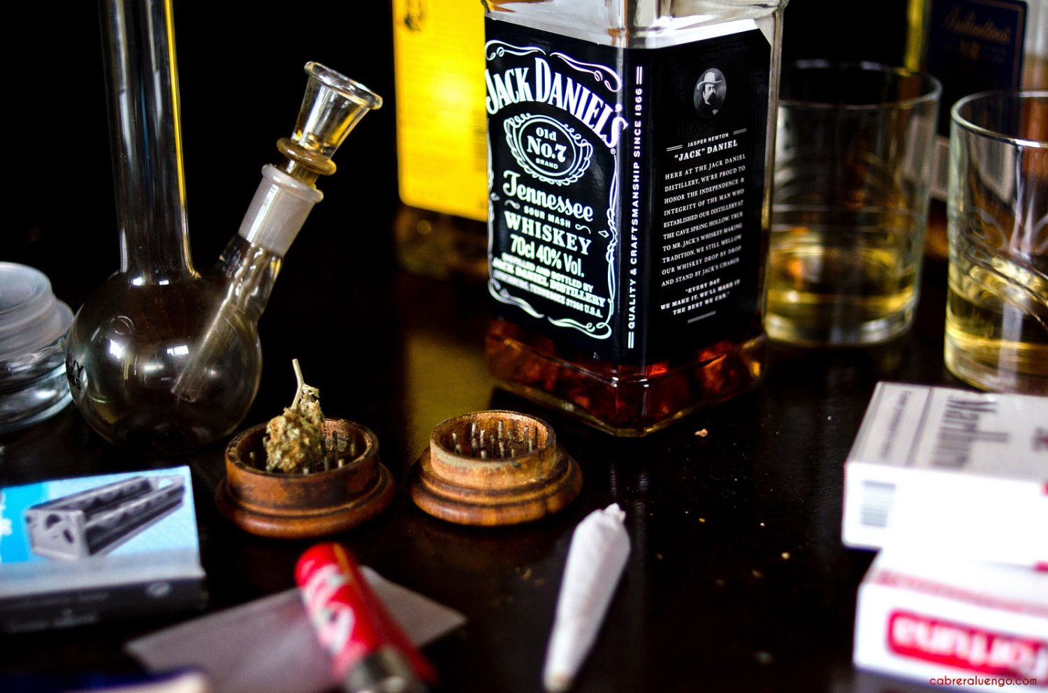
Causes of Spiritual and Physical Blindness: Alcohol and Drugs
(Prov cont’d) stingeth like an adder. ³³Thine eyes shall behold strange women, and thine heart shall utter perverse things. ³⁴Yea, thou shalt be as he that lieth down in the midst of the sea, or as he that lieth upon the top of a mast. ³⁵They have stricken me, shalt thou say, and I was not sick; they have beaten me, and I felt it not: when shall I awake? I will seek it yet again.
Notes:
Blinded of understanding, alcohol and other recreational drugs have caused many to behave in a way that has led to shame, loss, destruction, prison, and physical death. There is no shortage of current examples of how alcohol and drugs have destroyed lives and families – from the celebrity to the child killed by a drunk driver.
Alcohol can skew the physical senses, but it dims the mind to blindness when abused. It is estimated by some in the AA community that 1 in 13 who take the first drink will become alcoholics!
Drug laws and use continue to change in the U.S. Several states have moved to legalize drugs such as marijuana. It may be legal but the effects are still a loss of understanding pulling one into the pit. According to the 2018 Centers for Disease Control National Center for Health Statistics, life expectancy in the US dropped for the second year in a row. The opioid epidemic and increased suicide rate in our country are indicated as causes by experts looking at the data.
Indeed, this generation of Americans is the most medicated, counseled, drunk, drug abusing, in debt, and obese generation of American history. Yet, they are one of the unhappiest generations. (The newest generation is called the I-generation. Raised in a post 1997 world, they never knew a world without the iPhone. Today, people are addicted to their phone often because of social media. Yet, they are more suicidal and more unhappy than earlier generations. Such phone over use creates dopamine addicts. Today, people live in the most connected world of unconnected people).

Slide 24

Causes of Spiritual Blindness: Disobedience/Rebellion
Isa 42:6-10a “I, the Lord, have called You in righteousness, And will hold Your hand; I will keep You and give You as a covenant to the people, As a light to the Gentiles,⁷To open blind eyes, To bring out prisoners from the prison, Those who sit in darkness from the prison house.⁸I am the Lord, that is My name; And My glory I will not give to another, Nor My praise to carved images.⁹ Behold, the former things have come to pass, And new things I declare; Before they spring forth I tell you of them.”¹⁰Sing to the Lord a new song, And His praise from the ends of the earth,
Notes:
Disobedience and rebellion are causes of spiritual blindness.
God would hold the hand of his people and light their path if we would only let Him.
Isaiah 42:6-10a explains, “I, the Lord, have called You in righteousness, And will hold Your hand; I will keep You and give You as a covenant to the people, As a light to the Gentiles, To open blind eyes, To bring out prisoners from the prison, Those who sit in darkness from the prison house. I am the Lord, that is My name; And My glory I will not give to another, Nor My praise to carved images Behold, the former things have come to pass, And new things I declare; Before they spring forth I tell you of them. Sing to the Lord a new song, And His praise from the ends of the earth.”

Slide 25
Causes of Spiritual Blindness: Disobedience/Rebellion
Isa 42:14-20 “I have held My peace a long time, I have been still and restrained Myself. Now I will cry like a woman in labor, I will pant and gasp at once.¹⁵I will lay waste the mountains and hills, And dry up all their vegetation; I will make the rivers coastlands, And I will dry up the pools. ¹⁶I will bring the blind by a way they did not know; I will lead them in paths they have not known. I will make darkness light before them, And crooked places straight. These things I will do for them, And not forsake them.
Notes:
The Lord wants His servants to open their eyes and see through their blindness.
Isaiah 42:14-20 reads, “I have held My peace a long time, I have been still and restrained Myself. Now I will cry like a woman in labor, I will pant and gasp at once. 15 I will lay waste the mountains and hills, And dry up all their vegetation; I will make the rivers coastlands, And I will dry up the pools. 16 I will bring the blind by a way they did not know; I will lead them in paths they have not known. I will make darkness light before them, And crooked places straight. These things I will do for them, And not forsake them. 17They shall be turned back, They shall be greatly ashamed, Who trust in carved images, Who say to the molded images, ‘You are our gods.’ 18“Hear, you deaf; And look, you blind, that you may see. 19 Who is blind but My servant, Or deaf as My messenger whom I send? Who is blind as he who is perfect, And blind as the Lord’s servant? 20Seeing many things, but you do not observe; Opening the ears, but he does not hear.”

Slide 26
Causes of Spiritual Blindness: Disobedience/Rebellion
Isa 42:14-20 (Cont’d) ¹⁷They shall be turned back, They shall be greatly ashamed, Who trust in carved images, Who say to the molded images, ‘You are our gods.’¹⁸“Hear, you deaf; And look, you blind, that you may see. ¹⁹Who is blind but My servant, Or deaf as My messenger whom I send? Who is blind as he who is perfect, And blind as the Lord’s servant?²⁰Seeing many things, but you do not observe; Opening the ears, but he does not hear.”

Slide 27
Causes of Spiritual Blindness: Disobedience/Rebellion
Ezek 12:2-3 Son of man, you dwell in the midst of a rebellious house, which has eyes to see but does not see, and ears to hear but does not hear; for they are a rebellious house. ³“Therefore, son of man, prepare your belongings for captivity, and go into captivity by day in their sight. You shall go from your place into captivity to another place in their sight. It may be that they will consider, though they are a rebellious house.
Notes:
The battle between the spirit and the flesh continues as many who are spiritually blind are willing captives in spiritual warfare (Rom. 8:8-9).
Ezekiel 12:2-3 warns a rebellious house who has eyes that do not see to prepare for captivity, “Son of man, you dwell in the midst of a rebellious house, which has eyes to see but does not see, and ears to hear but does not hear; for they are a rebellious house. 3“Therefore, son of man, prepare your belongings for captivity, and go into captivity by day in their sight. You shall go from your place into captivity to another place in their sight. It may be that they will consider, though they are a rebellious house.”
Satan leads this rebellion as he seeks to devour others through his scheming while masquerading as an angle of light. (See John 8:44, 1 Pet. 5:8-9, 2 Cor. 4:4, 2 Cor. 2:11, Eph. 6:11, 2 Tim. 2:16, Lk. 4:2, Heb. 4:15, 1 Cor. 7:5, 2 Cor. 11:4).

Slide 28
Causes of Spiritual Blindness: Failure to Recognize God
Isa 44:18-20 They do not know nor understand; For He has shut their eyes, so that they cannot see, And their hearts, so that they cannot understand.¹⁹And no one considers in his heart, Nor is there knowledge nor understanding to say, “I have burned half of it in the fire, Yes, I have also baked bread on its coals; I have roasted meat and eaten it; And shall I make the rest of it an abomination? Shall I fall down before a block of wood?”²⁰He feeds on ashes; A deceived heart has turned him aside; And he cannot deliver his soul, Nor say, “Is there not a lie in my right hand?”
Notes:
Failure to recognize God causes spiritual blindness.
In most of the Old Testament, Israel failed to recognize God and turned to idolatry.
Today, some folks educate themselves away from God, failing to recognize God's wisdom and righteousness.
Besides worldly wisdom, there are many other idols today such as covetousness. Idolatry really is covetousness.
These idols blind and cause one to not recognize God.
Isaiah 44:18-20 speaks of such a time, “They do not know nor understand; For He has shut their eyes, so that they cannot see, And their hearts, so that they cannot understand. And no one considers in his heart, Nor is there knowledge nor understanding to say, ‘I have burned half of it in the fire, Yes, I have also baked bread on its coals; I have roasted meat and eaten it; And shall I make the rest of it an abomination? Shall I fall down before a block of wood?’ He feeds on ashes; A deceived heart has turned him aside; And he cannot deliver his soul, Nor say, ‘Is there not a lie in my right hand?’”

Slide 29


Causes of Spiritual Blindness: Failure to Recognize God
Romans 1:22-23, “Professing themselves to be wise, they became fools, And changed the glory of the uncorruptible God into an image made like to corruptible man….”
Idolatry still practiced today
Notes:
Idolatry is still just as prevalent today; however, it presents itself in a different form.
For example, the worship of sports, work, technology, money, or sexuality can be forms of idolatry.
As Paul wrote in Romans 1:22-23, “Professing themselves to be wise, they became fools, And changed the glory of the uncorruptible God into an image made like to corruptible man….”
Educated circles are often strong fields for showing contempt for recognizing God. Too many have “educated” themselves away from God. Their wisdom has blinded them from an eternal perspective.
This is not a slam against education, but upon on those who manipulate the education system to teach a different philosophy often born out of carnality or materialism.

Slide 30

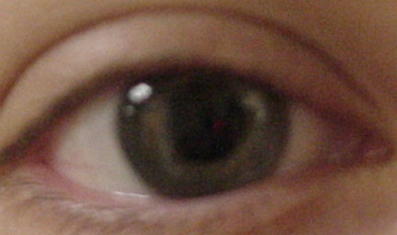
Causes of Spiritual Blindness: Unjust gain/Greed
Mt 6:22-25 ²²“The lamp of the body is the eye. If therefore your eye is good, your whole body will be full of light. ²³“But if your eye is bad, your whole body will be full of darkness. If therefore the light that is in you is darkness, how great is that darkness! ²⁴“No one can serve two masters; for either he will hate the one and love the other, or else he will be loyal to the one and despise the other. You cannot serve God and mammon.
Notes:
Greed or unjust gain causes spiritual blindness.
The way of Balaam remains one of the most powerful influences in our time.
Christ taught in Matthew 6:22-25 “The lamp of the body is the eye. If therefore your eye is good, your whole body will be full of light. 23“But if your eye is bad, your whole body will be full of darkness. If therefore the light that is in you is darkness, how great is that darkness! 24“No one can serve two masters; for either he will hate the one and love the other, or else he will be loyal to the one and despise the other. You cannot serve God and mammon.”
Mammon is wealth or possessions that exert an evil influence or are a false object of worship and devotion.

Slide 31
Causes of Spiritual Blindness: Unjust gain/Greed
Examples of Laeodocians
Rev 3:15-19 “I know your works, that you are neither cold nor hot. I could wish you were cold or hot. ¹⁶“So then, because you are lukewarm, and neither cold nor hot, I will vomit you out of My mouth. ¹⁷“Because you say, ‘I am rich, have become wealthy, and have need of nothing’—and do not know that you are wretched, miserable, poor, blind, and naked— ¹⁸“I counsel you to buy
Notes:
The Laodiceans serve as an excellent example because they were apparently known for their eye salves.
Revelation 3:15-19 tells us about their example: “I know your works, that you are neither cold nor hot. I could wish you were cold or hot. 16“So then, because you are lukewarm, and neither cold nor hot, I will vomit you out of My mouth. 17“Because you say, ‘I am rich, have become wealthy, and have need of nothing’—and do not know that you are wretched, miserable, poor, blind, and naked — 18“I counsel you to buy from Me gold refined in the fire, that you may be rich; and white garments, that you may be clothed, that the shame of your nakedness may not be revealed; and anoint your eyes with eye salve, that you may see. 19“As many as I love, I rebuke and chasten. Therefore be zealous and repent.”

Slide 32
Causes of Spiritual Blindness: Unjust gain/Greed
(Rev 3 cont’d) from Me gold refined in the fire, that you may be rich; and white garments, that you may be clothed, that the shame of your nakedness may not be revealed; and anoint your eyes with eye salve, that you may see. ¹⁹“As many as I love, I rebuke and chasten. Therefore be zealous and repent.
Notes:
The Laodiceans failed to be fully committed to God. Their tepid service to God was due to their confidence in their wealth and mammon instead of Jehovah.
They failed to see their status as miserable, poor, blind, and naked. Nor did they heed counsel to use their wealth serving God to be truly clothed having their blindness removed and not having the shame of their nakedness revealed to become spiritually rich.
Adam and Eve had their eyes opened to the shame of their nakedness in the Garden of Eden because of Satan’s lies.
The Laodiceans were blinded by carnal riches and were not able to see their own nakedness. Unfortunately, this is still all too common.
Christian must understand that God does not need their wealth, but they need Him to receive their efforts in service to Him, including their money.
Christians must first give of themselves and then their possessions with a cheerful heart, not grudgingly or of necessity, but with purpose.
Christians need to guard against wealth and greed as spiritual blinders.

Slide 33

Causes of Spiritual Blindness: Pride of Life (Men’s Approval/Hypocrisy/Uncommitted Heart)
John 12:43 for they loved the praise of men more than the praise of God.
People who believed but did not obey
Mt 15:7-9; 14 ⁷“Hypocrites! Well did Isaiah prophesy about you, saying:⁸‘These people draw near to Me with their mouth, And honor Me with their lips, But their heart is far from Me.⁹And in vain they worship Me, Teaching as doctrines the commandments of men.’ ”
¹⁴“Let them alone. They are blind leaders of the blind. And if the blind leads the blind, both will fall into a ditch.”
Notes:
33
Pride of Life causes spiritual blindness.
Spiritual blindness is also caused by a combination of different conditions that has pride of life at the core. Those who seek men’s approval, practice hypocrisy, or have an uncommitted heart suffer from spiritual blindness.
John 12:43 speaks of those who loved the praise of men more than the praise of God. Such pride blinds one to seeking God.
Also in this category, hypocrisy is a spiritual blinder.
Jesus refers to Isaiah speaking of those who draw to the Lord with their words but not their heart. In essence, they believed but did not obey; they were hypocrites.
Matthew 15:7-9 reads, “ ‘Hypocrites! Well did Isaiah prophesy about you, saying: These people draw near to Me with their mouth, And honor Me with their lips, But their heart is far from Me. And in vain they worship Me, Teaching as doctrines the commandments of men.’ ” Matthew 15:14 continues: “Let them alone. They are blind leaders of the blind. And if the blind leads the blind, both will fall into a ditch.”

Slide 34
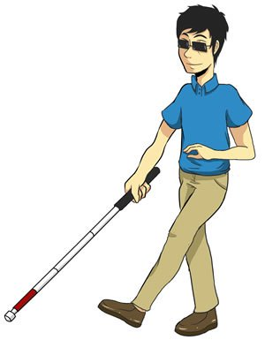
Causes of Spiritual Blindness: Pride of Life (Men’s Approval/Hypocrisy/Uncommitted Heart)
Blindness is failing to do, deluded hearers
Mt 23:16-17 ¹⁶“Woe to you, blind guides, who say, ‘Whoever swears by the temple, it is nothing; but whoever swears by the gold of the temple, he is obliged to perform it.’ ¹⁷“Fools and blind! For which is greater, the gold or the temple that sanctifies the gold?
Mt 23:23-28 ²³“Woe to you, scribes and Pharisees, hypocrites! For you pay tithe of mint and anise and cummin, and have neglected the weightier matters of the law:
Notes:
34
In the same category are those who fail to do as deluded hearers.
Matthew 23:16-17 instructs, “Woe to you, blind guides, who say, ‘Whoever swears by the temple, it is nothing; but whoever swears by the gold of the temple, he is obliged to perform it.’ 17“Fools and blind! For which is greater, the gold or the temple that sanctifies the gold?”
Matthew 23:23-28 continues, “Woe to you, scribes and Pharisees, hypocrites! For you pay tithe of mint and anise and cumin, and have neglected the weightier matters of the law: justice and mercy and faith. These you ought to have done, without leaving the others undone. 24“Blind guides, who strain out a gnat and swallow a camel! 25“Woe to you, scribes and Pharisees, hypocrites! For you cleanse the outside of the cup and dish, but inside they are full of extortion and self-indulgence. 26 “Blind Pharisee, first cleanse the inside of the cup and dish, that the outside of them may be clean also. 27“Woe to you, scribes and Pharisees, hypocrites! For you are like whitewashed tombs which indeed appear beautiful outwardly, but inside are full of dead men’s bones and all uncleanness. 28“Even so you also outwardly appear righteous to men, but inside you are full of hypocrisy and lawlessness.”

Slide 35

Causes of Spiritual Blindness: Pride of Life (Men’s Approval/Hypocrisy/Uncommitted Heart)
(Mt 23:23-28 cont’d) justice and mercy and faith. These you ought to have done, without leaving the others undone. ²⁴“Blind guides, who strain out a gnat and swallow a camel! ²⁵“Woe to you, scribes and Pharisees, hypocrites! For you cleanse the outside of the cup and dish, but inside they are full of extortion and self-indulgence.
Notes:
35

Slide 36
Causes of Spiritual Blindness: Pride of Life (Men’s Approval/Hypocrisy/Uncommitted Heart)
(Mt 23:23-28 cont’d) ²⁶“Blind Pharisee, first cleanse the inside of the cup and dish, that the outside of them may be clean also. ²⁷“Woe to you, scribes and Pharisees, hypocrites! For you are like whitewashed tombs which indeed appear beautiful outwardly, but inside are full of dead men’s bones and all uncleanness. ²⁸“Even so you also outwardly appear righteous to men, but inside you are full of hypocrisy and lawlessness.
Notes:
Too often, in hypocrisy, people fear humans more than God.
Solomon warned in Proverbs 29:25, “The fear of man bringeth a snare: but whoso putteth his trust in the LORD shall be safe.”
Christians must seek not what is right in their eyes, but what is righteous in God’s eyes putting away hypocrisy as caused by the pride of life, seeking of men’s approval, and fully commit their heart to God.
36

Slide 37

Causes of Spiritual Blindness: Prejudice
A few generations ago, many under the banner of Christ and the church carried on the cause of racial prejudice, failing to see others as children of Light and fellow souls, while failing to carry out the golden rule of treating other as you want to be treated (Luke 6:31). This was wrong.
James 1:17 teaches there is no shadow of turning with God.
In the New Testament times, the fleshly division was the Jews and the Gentiles (Acts 10 and 22).
Notes:
Prejudice causes spiritual blindness.
A few generations ago, many under the banner of Christ and the church carried on the cause of racial prejudice failing to see others as children of God and fellow souls. As a result, they neglected to carry out the golden rule Jesus instructed in Luke 6:31 of treating others as you want to be treated. This was wrong.
James 1:17 teaches “Every good gift and every perfect gift is from above, and cometh down from the Father of lights, with whom is no variableness, neither shadow of turning.” God is no respector of persons.
In the New Testament times, the fleshly division was the Jews and the Gentiles (Acts 10 and 22).

Slide 38
Causes of Spiritual Blindness: Prejudice
People often still have preconceived judgments or opinions of others without grounds but instead based on race, birth place, or bank accounts instead of experience with the person. This is wrong.
Prejudice blinds to whom a person may truly be.
Hebrews 2:9 notes, “But we see Jesus, who was made a little lower than the angels for the suffering of death, crowned with glory and honour; that he by the grace of God should taste death for every man.”
Christians must guard against prejudice because it spiritually blinding while carrying hatred and pride as accompaniment .
Notes:
People often still have preconceived judgments or opinions of others without grounds and base their opinions on race, birth place, or bank accounts instead of experience with the person. Again, this is wrong.
Prejudice blinds who a person truly is.
Hebrews 2:9 notes, “But we see Jesus, who was made a little lower than the angels for the suffering of death, crowned with glory and honour; that he by the grace of God should taste death for every man.”
Christians must guard against prejudice because it is spiritually blinding carrying hatred and pride as accompaniment.

Slide 39
Causes of Spiritual Blindness: Failure to Know God’s Word
Jeremiah 5:4 Therefore I said, “Surely these are poor. They are foolish; For they do not know the way of the Lord, The judgment of their God.
Jeremiah 5:20-22a “Declare this in the house of Jacob And proclaim it in Judah, saying,²¹ ‘Hear this now, O foolish people, Without understanding, Who have eyes and see not, And who have ears and hear not: ²²Do you not fear Me?’ says the Lord
Notes:
Failure to know God’s Word results in spiritual blindness.
One cannot be directed by what one does not know.
God lamented in Hosea 4:6a, “My people are destroyed for lack of knowledge…”
Jeremiah 5:4 observed, “Therefore I said, Surely these are poor. They are foolish; For they do not know the way of the Lord, The judgment of their God.”
Jeremiah 5:20-22a continues, “Declare this in the house of Jacob And proclaim it in Judah, saying, ‘Hear this now, O foolish people, Without understanding, Who have eyes and see not, And who have ears and hear not: Do you not fear Me?’ says the Lord.” Today, even with eyes, one can be blind due to lack of knowledge of God's word.

Slide 40
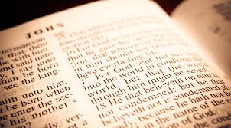
Causes of Spiritual Blindness: Failure to Know God’s Word
Jesus walks out on the water and disciples afraid
Mark 6:52 for they had not understood about the loaves, because their heart was hardened.
Prov 29:18Where there is no vision, the people perish: but he that keepeth the law, happy is he.
Notes:
One can also easily fail to see what is right in front of them.
As a parent, this author has been at that place with his children. After having instructed my children something repeatedly, they still do not seem to get the idea. I wonder how they do not see it.
Similarly, many have re-read or re-examined something wondering how they missed something when they had looked at it previously.
Perhaps one of the more common illustrations is when one informationally knows the truth of God’s word but fails to be a doer of the word. One might call this the difference between informational and transformational status in an individual.
A lack of vision or direction based on God’s word can yield a spiritual near sightedness.
In Mark 6:52, the disciples failed to understand about the loaves because their heart was hardened.
The child of God’s vision must be on the eternal.
Proverbs 29:18 instructs, “where there is no vision, the people perish: but he that keepeth the law, happy is he.”
Christians can be happy by obeying God’s righteousness, keeping their eye on Jesus, looking to heaven, but one cannot help but be blind without knowing the light to guide their feet.

Slide 41

Some Causes of Spiritual Blindness
Pride
Self-righteousness
Lust
Alcohol/Drugs
Disobedience/Rebellion
Failure to recognize God
Unjust gain/greed
Pride of Life: Men’s approval/hypocrisy/ uncommitted Heart
Prejudice
Failure to know God’s word
Notes:
There are many causes of spiritual blindness.
Some include: pride, lust of the flesh, the lust of the eyes, self-righteousness, alcohol and drugs, disobedience/rebellion, a failure to recognize God, greed and mammon, hypocrisy, seeking men’s approval (pride of life items), prejudice, and a failure to know God’s word.
It is easy to delude ourselves into just being a hearer and not a doer of the word leading to a state of spiritual blindness.

Slide 42
Conclusion
Spiritual blindness allows one to lie to themselves.
Zephaniah 1:17 warned the blind, “And I will bring distress upon men, that they shall walk like blind men, because they have sinned against the LORD: and their blood shall be poured out as dust, and their flesh as the dung.”
There are many causes of spiritual blindness.
It is easy to delude the self into just being a hearer and not a doer of the word, leading to a state of spiritual blindness.
Notes:
Spiritual blindness allows one to lie to themselves.
Zephaniah 1:17 warns the blind, “And I will bring distress upon men, that they shall walk like blind men, because they have sinned against the LORD: and their blood shall be poured out as dust, and their flesh as the dung.”
This begs an important question: How does one combat spiritual blindness setting aside the sin that so often side tracks everyone?
Luke 4:18 records that Jesus came to give sight to the blind.
However, Satan’s goal is the opposite. Satan’s crafty schemes to keep humans blind spiritually are very real.
We must properly diagnose our blindness and make a conscience effort to seek out the light for spiritual healing.
Jesus encourages in John 8:12, “I am the light of the world: he that followeth me shall not walk in darkness, but shall have the light of life.”
To guide us in our path to light, God has given Christians powerful weapons to combat blindness in our everyday battle.
You have been given a choice. Will recognize your spiritual blindness and choose to set your path towards the light by putting on the whole armor given to us by God (Eph. 6:10-18)?

Slide 43
Conclusion
How does one combat spiritual blindness, setting aside the sin that so often side tracks everyone?
Luke 4:18 tells that Jesus came to give sight to the blind.
Satan’s crafty schemes to keep humans blind spiritually are very real.
God has given christians powerful weapons to combat blindness (Eph 6:10-18).
Notes:
We must properly diagnose our blindness and make a conscience effort to seek out the light for spiritual healing.
Jesus encourages in John 8:12, “I am the light of the world: he that followeth me shall not walk in darkness, but shall have the light of life.”
To guide us in our path to light, God has given Christians powerful weapons to combat blindness in our everyday battle.
You have been given a choice. Will recognize your spiritual blindness and choose to set your path towards the light by putting on the whole armor given to us by God (Eph. 6:10-18)?

Slide 44
Conclusion
1 Cor 2:9-11, “But as it is written, Eye hath not seen, nor ear heard, neither have entered into the heart of man, the things which God hath prepared for them that love him. But God hath revealed them unto us by his Spirit: for the Spirit searcheth all things, yea, the deep things of God. For what man knoweth the things of a man, save the spirit of man which is in him? even so the things of God knoweth no man, but the Spirit of God.”
John 8:12, “I am the light of the world: he that followeth me shall not walk in darkness, but shall have the light of life.”

